Slide 1
Tableau Dashboard.
BY: Jerin Joseph
BDS BATCH
25 MAY

Slide 2
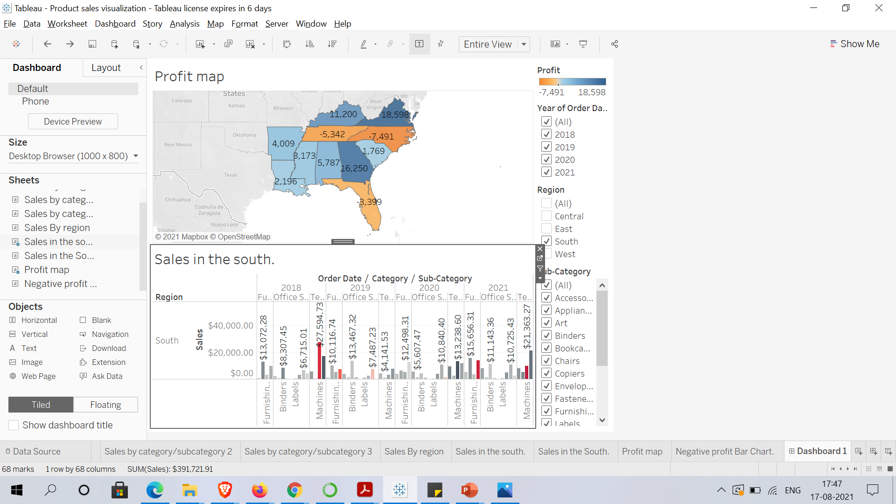
Build dashboard using the worksheets ‘profit map’ and ‘sales in the south’ to show some insights.

Slide 3
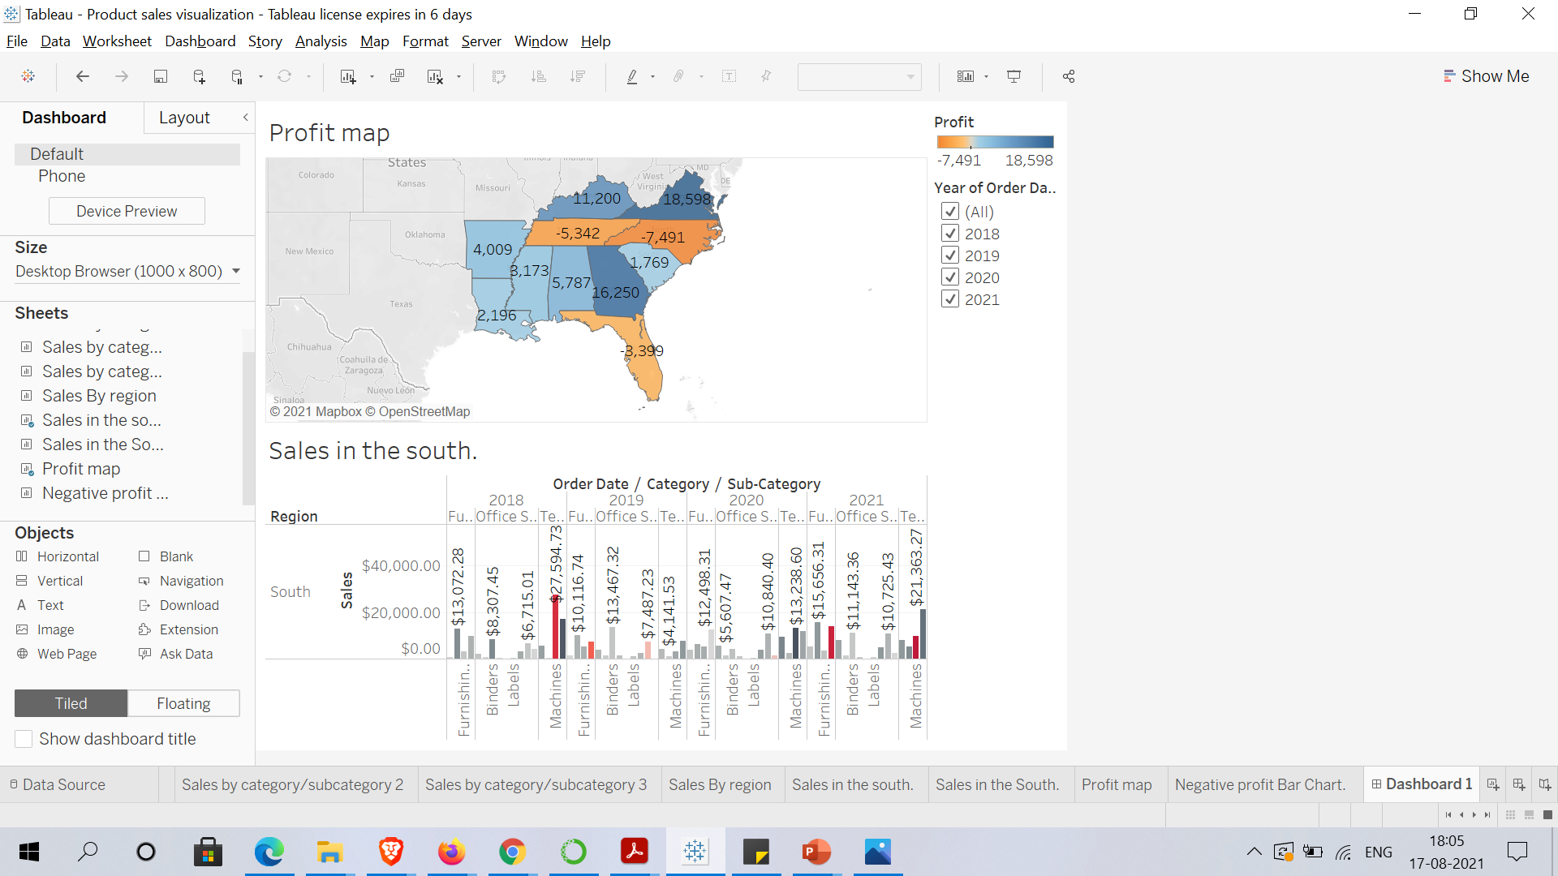
Remove the subcategory filter and other filters except ‘Year of order date’ option to vacate the space.

Slide 4
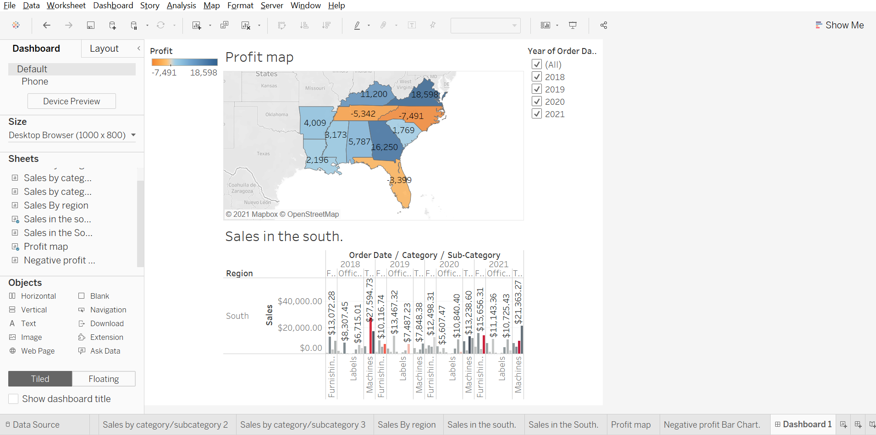
Select Profit color legend and drag it to Sales in the South.

Slide 5
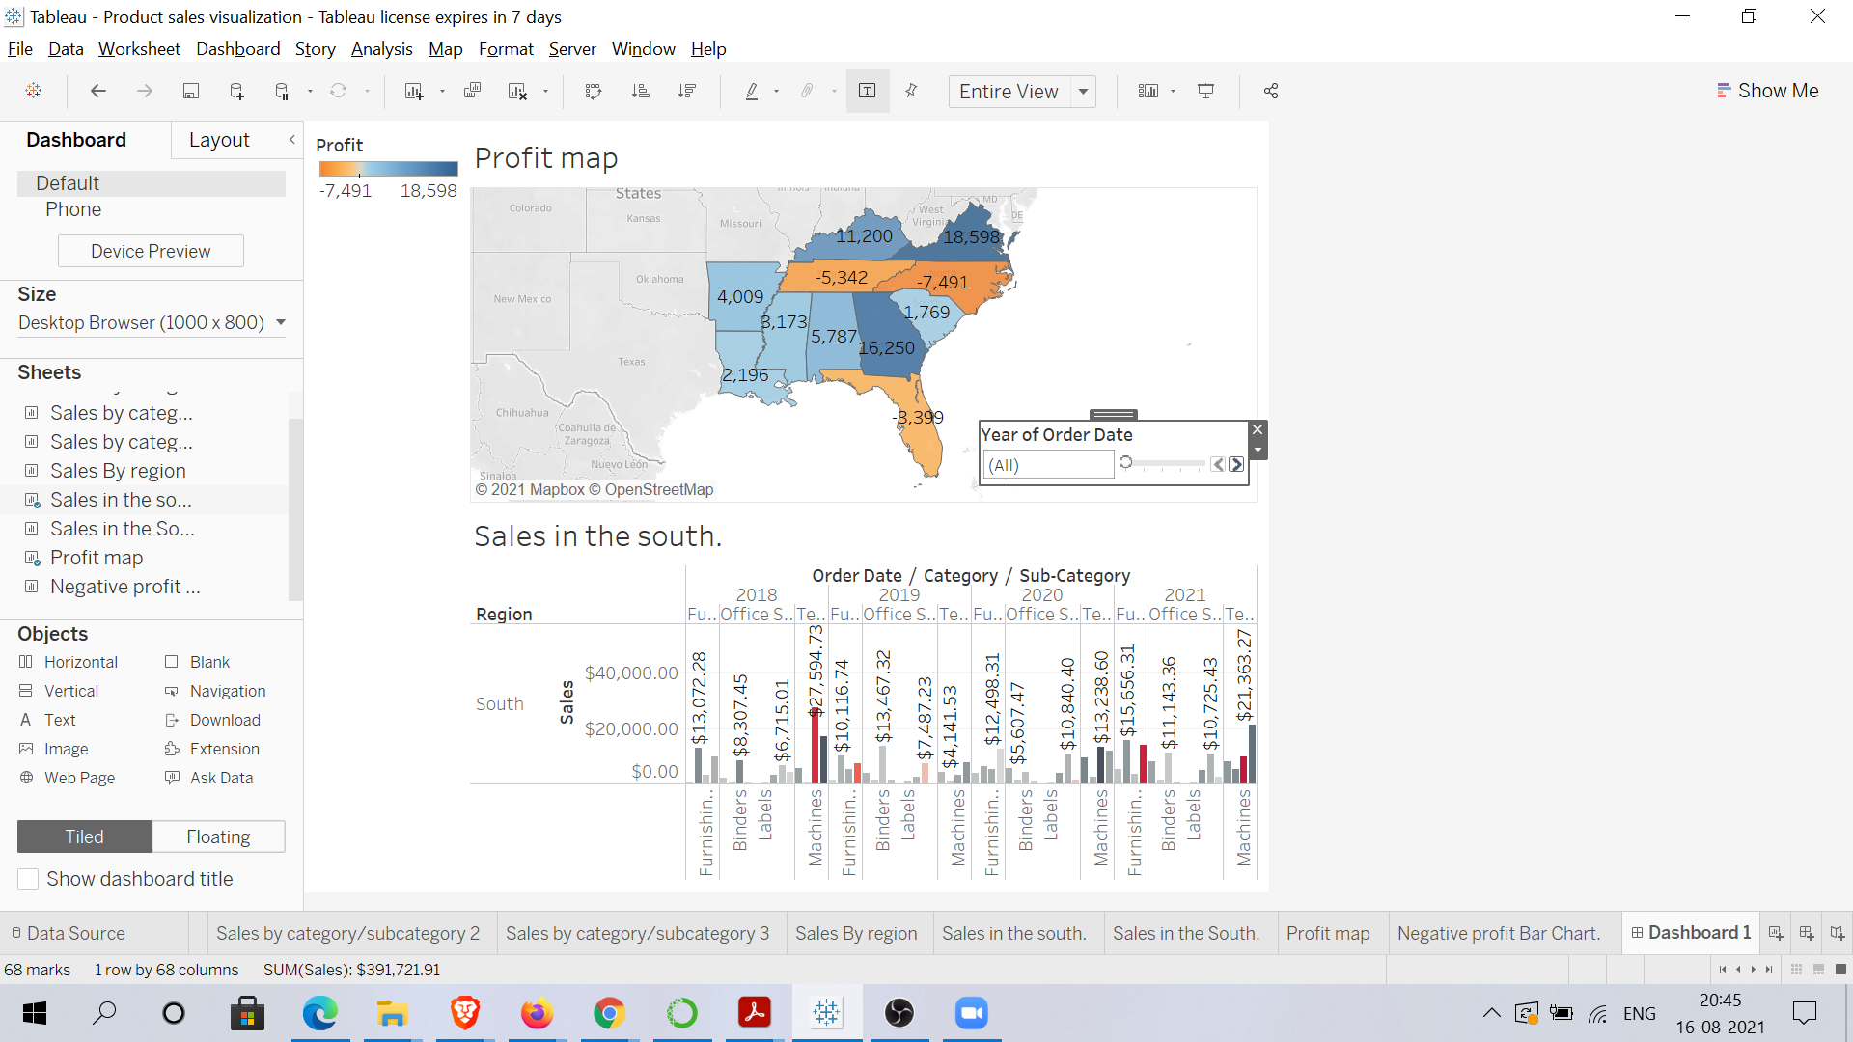
Create a slider for order of date filter.

Slide 6
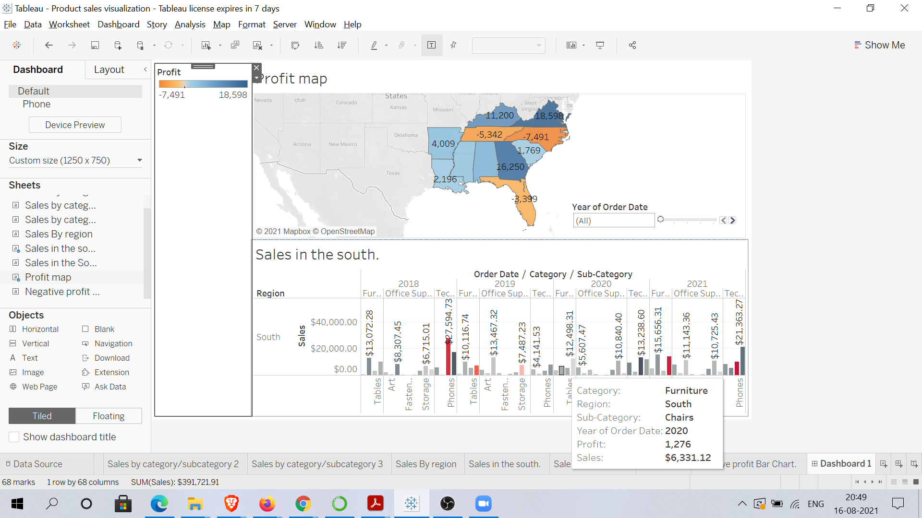
Resize your dashboard and make it 1250px wide by 750px length.

Slide 7
Make your dashboard interactive.

Slide 8
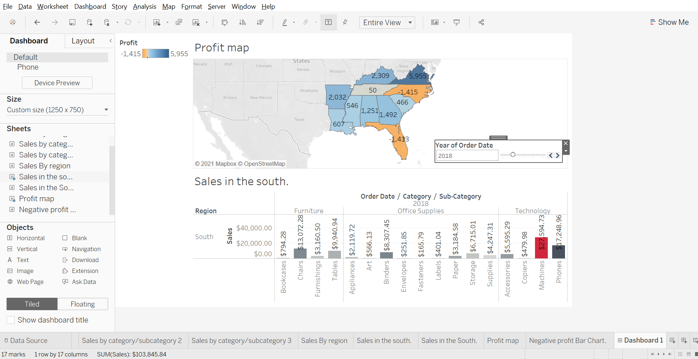
Show change in profits in the profit map based on the order date in your in your interactive dashboard.

Slide 9
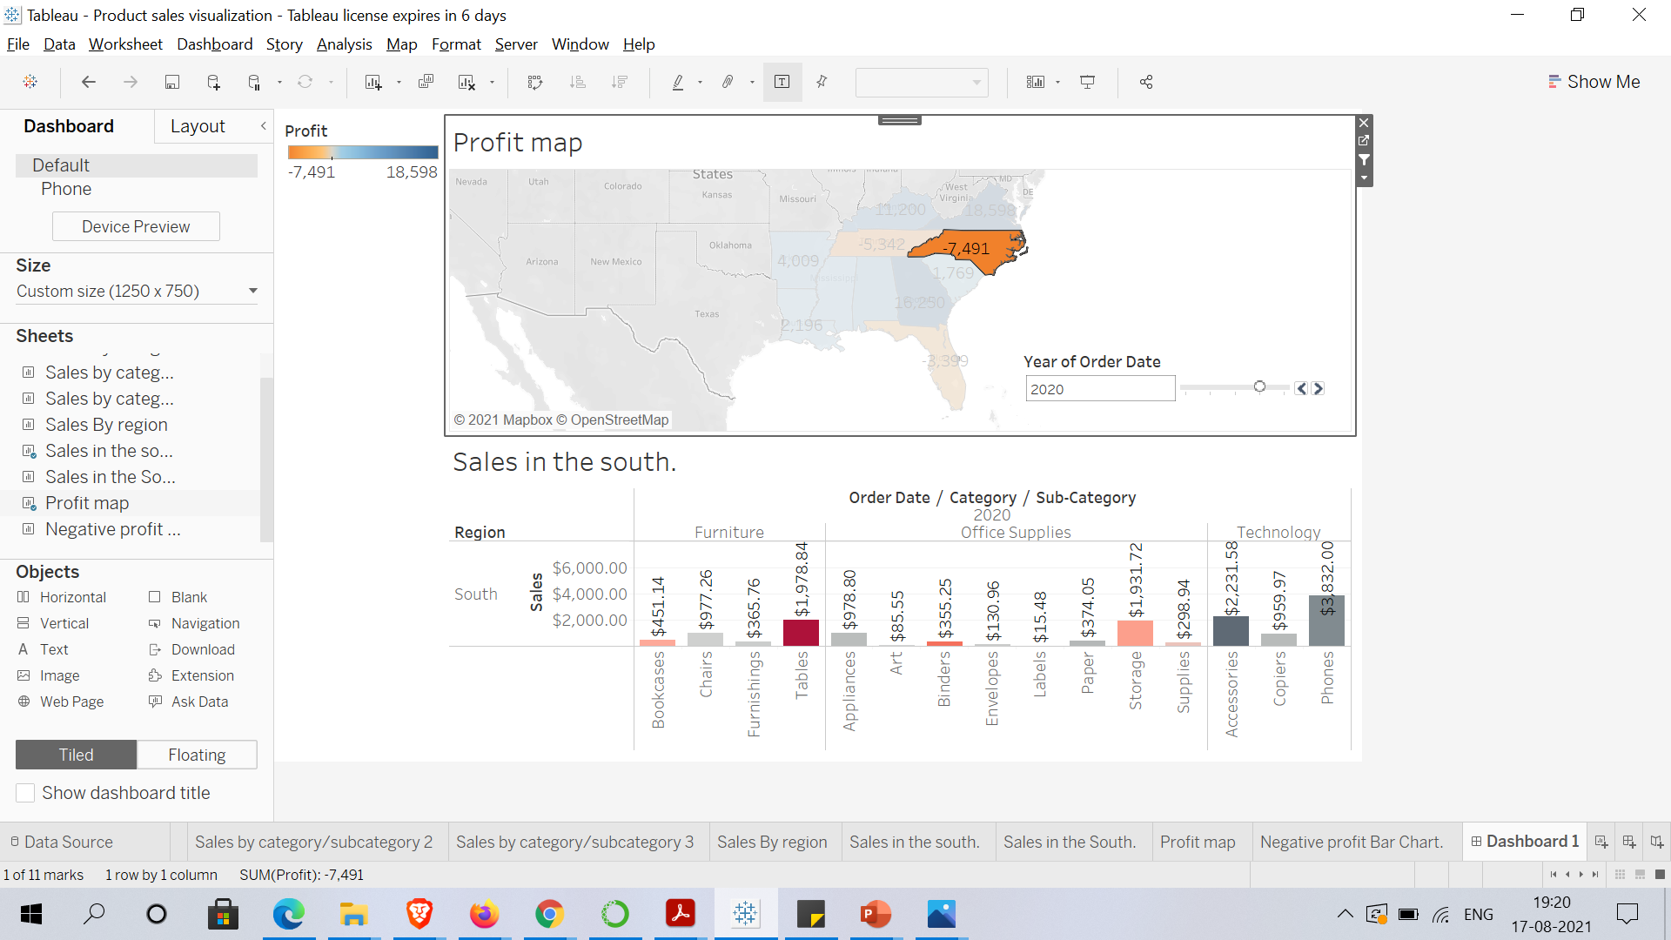
One by one click all the states in the profit map having negative profit and check both profit and sales for each state

